Slide 1
Unit Identification Code Practicum
Tri-Service Hearing Technician
4.2 Certification Course

Slide 2
Unit Identification Code Practicum Learning Objectives
2.1.1 Understand the service format for UIC/WICs
2.1.2 Understand how to use the UIC Locator
2.1.3 Find Unit Identification Codes (UICs)
2.1.4 Add, edit and delete UICs from DOEHRS-HC
2.1.5 Test personnel under the correct service UIC/WIC
Tri-Service Hearing Technician 4.2 Certification Course

Slide 3
Unit Identification Code Practicum Service Unit Identification Code (UIC) Format
Army starts with a “W” followed by five alpha and/or numeric characters (Wxx#xx)
All Army (USA) are tested under their service UIC
Coast Guard consists of 7 alpha and/or numeric characters (##xx#x#)
All Coast Guard (USCG) are tested under their service UIC
Marine Corps consists of 8 alpha and/or numeric characters (##xx#x#x)
Marine Corps (USMC) can be tested under USMC or USN UICs
USMC may be in the same unit with USN but have a USMC UIC
Navy consist of five alpha and/or numeric characters (xx#xx)
Navy (USN) can be tested under USN or USMC UICs
USN may be in the same unit with USMC but have a USN UIC
Tri-Service Hearing Technician 4.2 Certification Course

Slide 4
Unit Identification Code Practicum Service Workplace Identification Code (WIC) Format
Air Force has four numbers – four letters – 3 numbers followed by a letter (####-XXXX-###X).
This is a WIC
It is issued to USAF personnel on USAF bases in the HCP by a USAF Bio-Environmental Engineers (BEE)
If you are testing at a USAF base, test USAF under the WIC issued by the Bio-Environmental Engineer of that base
USAF patients stationed at USMC/USN bases, the test site will use: 1234-NAVY-123N and type their unit in the demographic data section on the run test window in the location field
Tri-Service Hearing Technician 4.2 Certification Course

Slide 5
Unit Identification Code Practicum Learning Objectives
Enter a small amount of information in the query/filter
Use filter to pull up the answer
Re-query when you see how the data/records retrieved are recorded
Data queried needs to be typed exactly as it is in the database (space, dash or slash)
If the query has too much information or is not typed exactly the way it is in the database the answer pool will not find data
Under text filter change equals (default) to contains
Use single or multiple filters, Service, City, State or partial Unit name
Tri-Service Hearing Technician 4.2 Certification Course Video Next Slide

Slide 6
Notes:
Approximately 5 minute UIC video
Control F (any part of field versus whole field) to search within the access database
Discuss how to filter and then remove filter (clear all settings)

Slide 7
Unit Identification Code Practicum UIC Locator Practicum
1st Mar Raider Bn, Camp Pendleton CA MACOM = SOCOM
Service: USN
Coast Guard Cutter Alert MACOM = D13
Service: USCG
USS San Antonio LPD-17 MACOM = SURFLANT
Service: USMC
Under Unit>Text Filters>Custom Filter enter Raider
City = Camp Pendleton
Write down appropriate information (page 48)
Tri-Service Hearing Technician 4.2 Certification Course Video Next Slide
Notes:
Practicum is located in the training booklet to write the UICs from the UIC locator
Find the DOD Component, UIC, City, State, Zip Code and Major Command for the following units
You may have to adjust the wording/spelling to get the correct data. These UICs will be used in following exercises. If there is FPO followed by 2 letters then the FPO will be the city and the following 2 letters will be the state followed by the zip code.
USN - 1st Mar Raider Bn, Cp Pendleton = 67930
USCG - Coast Guard Cutter Alert = 1000487
USMC - USS San Antonio LPD-17 = 20001761

Slide 8
Notes:
2 minute video- Add UIC into DOEHRS-HC
Throughout DOEHRS-HC, previous drop down selections limit future drop down choices
Have student enter the 3 UIC/WIC into DOEHRS UIC database from their training booklet
Stay on this slide until students are done

Slide 9
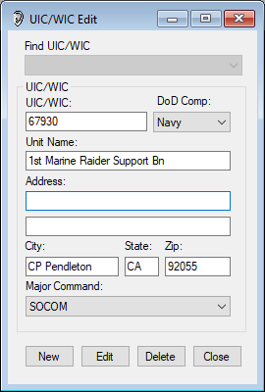
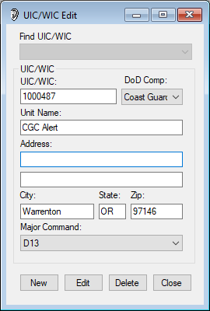
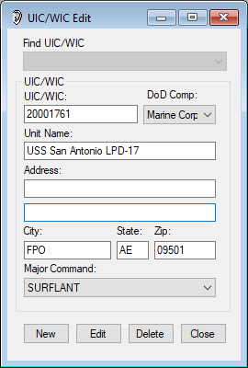
Unit Identification Code Practicum UIC Database
Tri-Service Hearing Technician 4.2 Certification Course
Notes:
Ensure students have the correct information in DOEHRS-HC

Slide 10
Unit Identification Code Practicum UICs are Important
Patients require their UIC to be entered and/or selected for their audiogram
Most HCP reports are created via the patient UIC
Contact your HCPM for any UIC questions you may have
Enter UIC in the location you are entering patient data (right click to add) otherwise you will need to refresh the screen
USN, USMC and USCG add the Major Command when entering the UIC
Note: USA/USAF do not require MACOM with UIC entry
Tri-Service Hearing Technician 4.2 Certification Course

Slide 11
Unit Identification Code Practicum Unit Identification Code
Established “core” UICs
Core UICs are UICs that belong to the units that are frequently tested at the DOEHRS-HC word station/testing site
Unit Safety personnel work in conjunction with the HCPM to identify personnel and units exposed to hazardous noise
A DR Inquiry may bring down associated sub-table UICs for non-Air Force military personnel if the UIC is not in the local database
This will not bring add the MACOM with the UIC
Always export records to the DR prior to deleting any UICs from the local database (incomplete records)
Tri-Service Hearing Technician 4.2 Certification Course

Slide 12
Unit Identification Code Practicum Summary
Service format of UIC/WICs
UIC Locator
Unit Identification Codes
Add, edit and delete UICs from DOEHRS-HC
Test personnel under the correct service UIC/WIC
Tri-Service Hearing Technician 4.2.0.0 Certification Course

Slide 13
Unit Identification Code Practicum
? Questions ?
Tri-Service Hearing Technician
4.2 Certification Course

